Slide 1

International Recruitment Webinar
10:00am on 1 December 2023
Notes:
Welcome Everyone
Housekeeping – Raise Hand
Recording session to share for those that can’t make it.

Slide 2

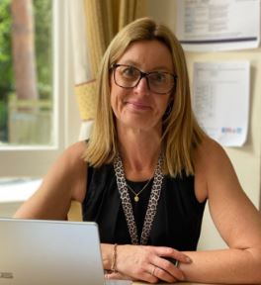
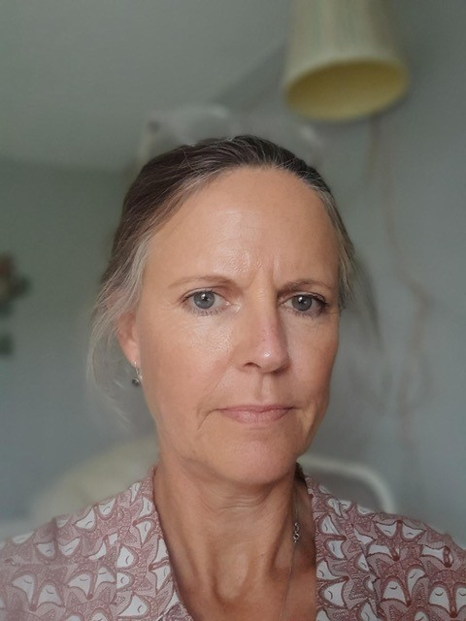
Welcome
Anna Knight
Development Lead
Billy Lintell
International Recruitment Support Officer
DCA Membership & Administration

Slide 3
Agenda
Anna Knight & Billy Lintell, Dorset Care Association
Ollie Counter – Gloucestershire Care Providers Association
Philippa King – Shiva Foundation
Adrian Henderson – RWK Goodman
Jeanette A’Court & Thomas, Culliford House Care Home
Katherine Felton & Chipo, Windsor Court Care Home
Matthew Bond – Borderless
Any Questions?
Notes:
We have a packed agenda. If possible please keep any questions to end.

Slide 4



Project Funding
Notes:
Ollie to explain more about the funding

Slide 5




Support for Care Providers
Development of collaborative Care Provider resources via online and direct support:
Certificate of Sponsorship and SMS queries
Recruitment process guidance
Industry and legislation updates
International recruitment focused webinars for Care Providers with industry experts
Links with other local providers to act as mentors
Forum for Care Providers
Awareness and resources on modern day slavery and exploitation
Guidance on how to successfully onboard new overseas worker employees
Notes:
General queries on SMS and recruitment process answered
Legislation upates: EG Govt Sources are predicting the following changes to IR for Social Care:
Restrictions on family joining from overseas
Minimum salary of £35K
any other work carried out to be limited to work in regulated care setting
Anyone willing to be mentor or looking for a mentor please get in touch with Billy
Commissioned Shiva Foundation to work on project to provide resources to raise awareness, training, collaboration with other agencies and support – more from Philippa later.
Guide book from GCPA – when available?

Slide 6



Support for International Workers
International Worker Support:
Pastoral support including links with established local communities, places of worship etc
Modern day slavery and exploitation awareness, help line and support
Accommodation support
Driving lessons for Dom Care (if budget allows)
Notes:
Pastoral: Banking system, post office, Phones, clothing, furnishing house, shopping - more in guide.
Modern Day Slavery – more from Shiva but can help with signposting for help and support
Accommodation – difficult in Dorset. Investigate Home Share. Currently no providers in Dorset.

Slide 7


Modern Day Slavery
www.unseenuk.org
08000 121 700
www.modernslavery.gov.uk
0800 0121 700

Slide 8
For more information, help or guidance please contact: billy.lintell@dorsetcare.co.uk

